Slide 1
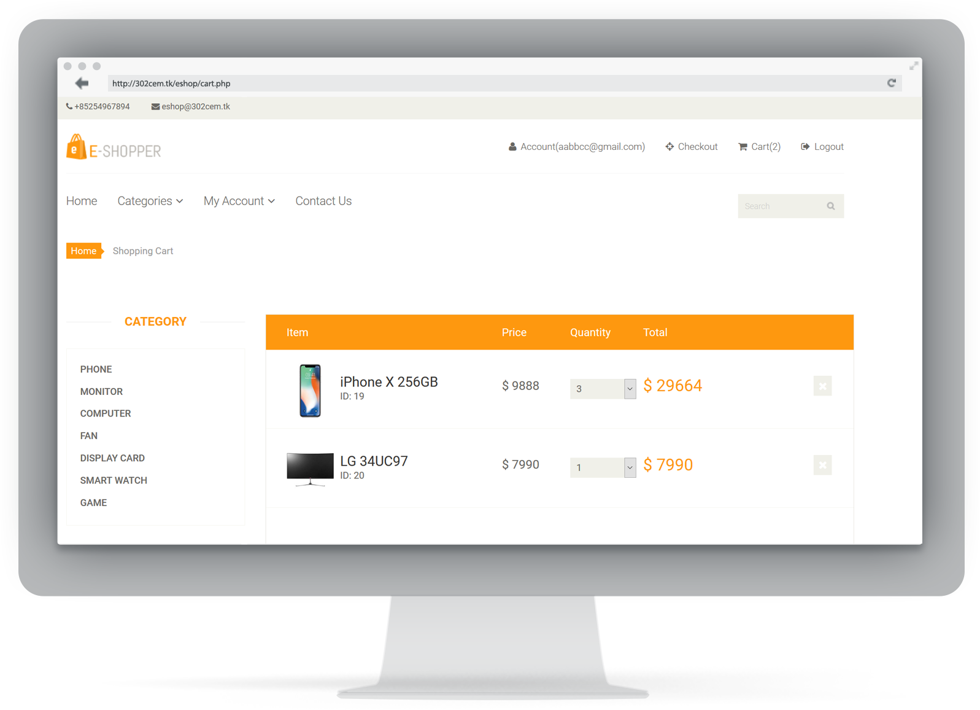
302COM Group 2 Project Presentation

Slide 2
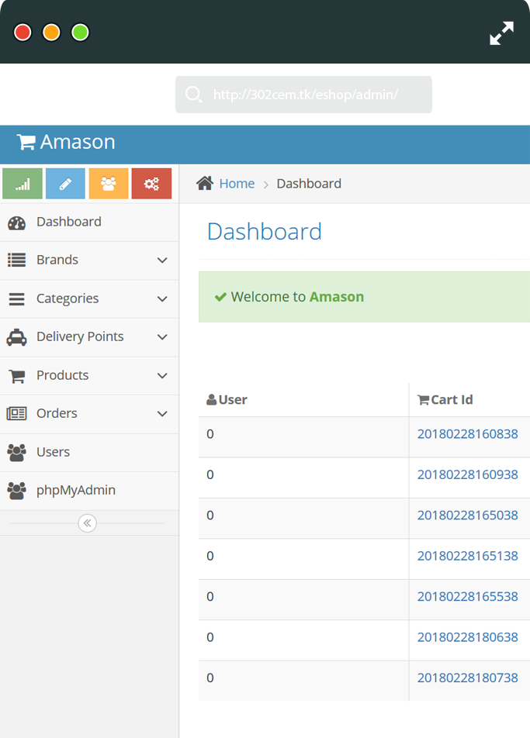
Group 2
Members
List
Raymond, Liu Wai Man, 54923807
Kami, Ng Ka Ming, 55266014
Andy, Fong Cheuk Lok, 54851230
Victor, Lau Chun Hang, 55265970
Tommy, Poon Wai Lok, 55270710

Slide 3

Project Vision and Mission
Role
Vision
Our vision in this project which is design and develop a online shopping website for users so that they can buy our products at home. Also, the customers can enjoy a personalized E-commerce experience no matter where they at. As e-commerce growing up very fast, the customer can browse our online shopping website with any device such as, smartphones, notebook, desktop etc.
We should continuously innovate and keep improve our service to gain more confidence from the customers.
Mission
Our mission is to be successful and gain customers confidence in local. We develop the online shop website to providing seamless and localized service. Furthermore, our website also provide customer and product replacement services.

Slide 4
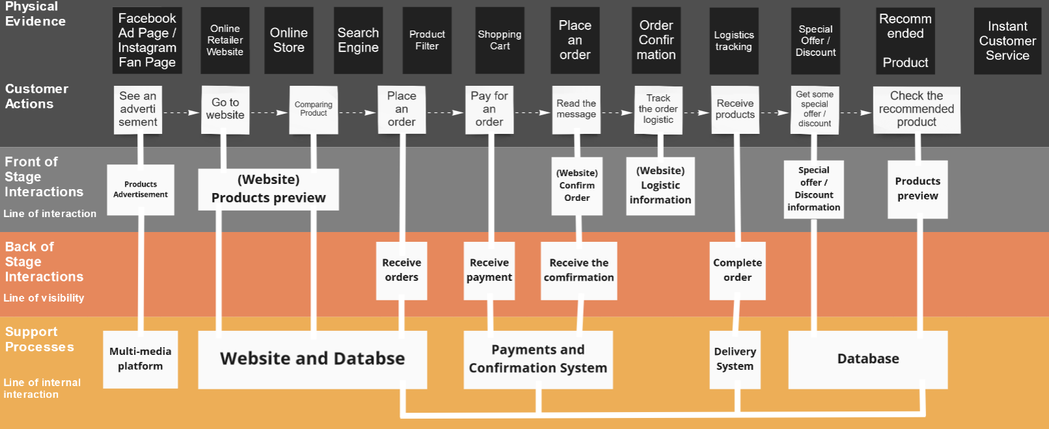
Service Blueprint
Notes:
This is our service blueprint.
The main components of the service blueprint which are Physical Evidence, Customer Actions, Front of Stage Interactions, Back of Stage Interaction and Support Process.
We are online retailer, the service blueprint in physical Evidence and Customer Actions user will see the main online retailer website, recommended product, shopping cart and order confirmation. On the other hand, Front of Stage Interactions will have products preview and confirm order. Next, the back of stage interactions is mainly receive orders and receive the confirmation. Finally, Support Processes is also the most important. Includes website database, payments and confirmation system.

Slide 5
User Stories
1. As an online retailer, I want to order product from supplier so that I have product to sell on the website
2. As an employee, I want to confirm the ordered products are shipped to the warehouse so that I can update the database of the product storage
3. As a customer, I want to select product from the website so that I can buy the product
4. As a customer, I want to select product details (e.g. size, color, etc.) so that I have more choices of the product
5. As I customer, I want to select product quantity so that I can buy more same product at the same time
6. As a customer, I want to select a shipping address so that I can decide which address to receive the product
7. As I customer, I want to select shipping speed (e.g. 5 days) so that I can receive the product within the period
8. As a customer, I want to select payment method so that I have to pay for the product
9. As an online retailer, I want to select related customer product shipping details from database so that I can notify the logistics provider
10. As a logistic, I want to receive product shipping details from online retailer so that I can transport the product to customer address
Notes:
This is the user stories. There are four different types of character for drafting the user stories, which are online retailer, employee, customer and logistic.
The user stories are basically the product shipping process.
In order to sell the product on the website, our warehouse should have product first, so we need to order product from supplier. When the product are shipped to our warehouse, our employee should confirm the product to ensure the product is correct. And then update the product inventory database.
When we have product in the warehouse, customer can buy the product on the website and select product details such as size, color and quantity. In order to receive the product, customer should input their shipping address on the transaction page. They can also select shipping speed like for 5 days so that they can receive the product within the period. And finally they need to select the payment method so that they have to pay for the product.
After the input of customer information, the transaction is successful. The related logistic company will receive product shipping details from us. And then ship the product to customer address.

Slide 6
Gherkin Sample Template
For Logistics
Product Code | Product Description | Ordered Quantity | Order Date
Shipping Address 1,2,3,4 | Customer Phone no. | Customer Email | Shipping Fee
Product Weight | Product Size | Customer Code | Customer Name
Order Code | Logistic Code | Logistic Name
For Supplier
Supplier Code | Stock Order no. | Supplier Name | Order Quantity
Order Date | Order Product Code | Product Price
Notes:
Let’s move on to the Gherkin Sample Template.
There are two tables on the screen, let’s talk about left hand side table first. The left hand side table is the data that we would send to logistic after transaction is made successfully. When customer log an order case, there are some fields for logistics. Which are Customers’ name / Shipping address 1, 2, 3, 4 / Customer Phone no. Those information is for logistics to communicate with customer. Moreover, the logistic code and name are for us to identify which logistic company is working for this order.
Let’s move on to the right hand side table, which is the data that we would send to supplier. When the warehouse is out of stock, we need to contact supplier company to order product. The field Stock Order no. & Order Product Code is useful. When we contact supplier, we need to log an order case to supplier. Stock Order no. is recorded as a order number of ordering products at that time. And the Order Product Code is for identifying which product we ordered.

Slide 7
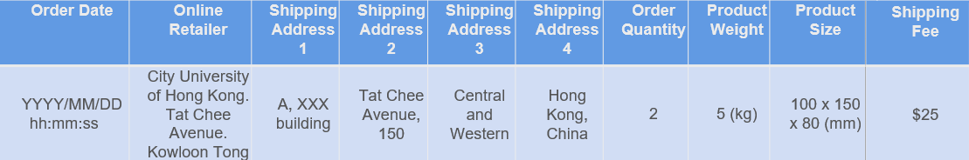
Data Interface Layout
Order Code | Product Code | Logistic Code | Customer Code | Product Description | Logistic Name | Customer Name | Customer Phone No. | Customer Email
OC000001 | PC000001 | LC000001 | CC000001 | Iphone X, 64 GB, Black | Group 4,5 | Mr. A | +852 61234567 | customer@gmail.com
Notes:
Turning our attention to the data interface layout.
There are two table shown. two table are for the logistic company.
This is the sample data that we may send to logistics. We have communicated with logistics and they agree those data type we set in the sample data. Logistics and us are using the same data type in the database in order to have precise file transferring. And the sample data for supplier is the same purpose, so we don’t show that here.

Slide 8
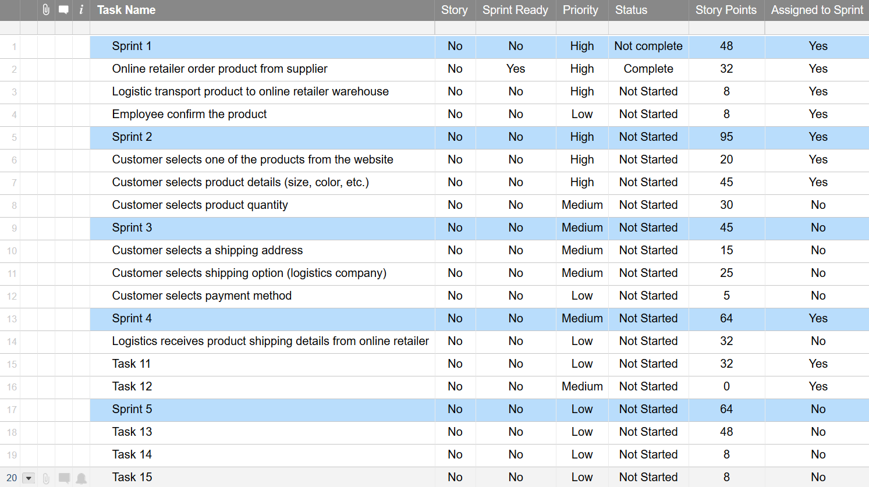
Product Backlog
Agile Methodology
Notes:
In this Product Backlog. We will show the sorted way, the more important and more preferred construction items (function and feature) are placed in front......

Slide 9
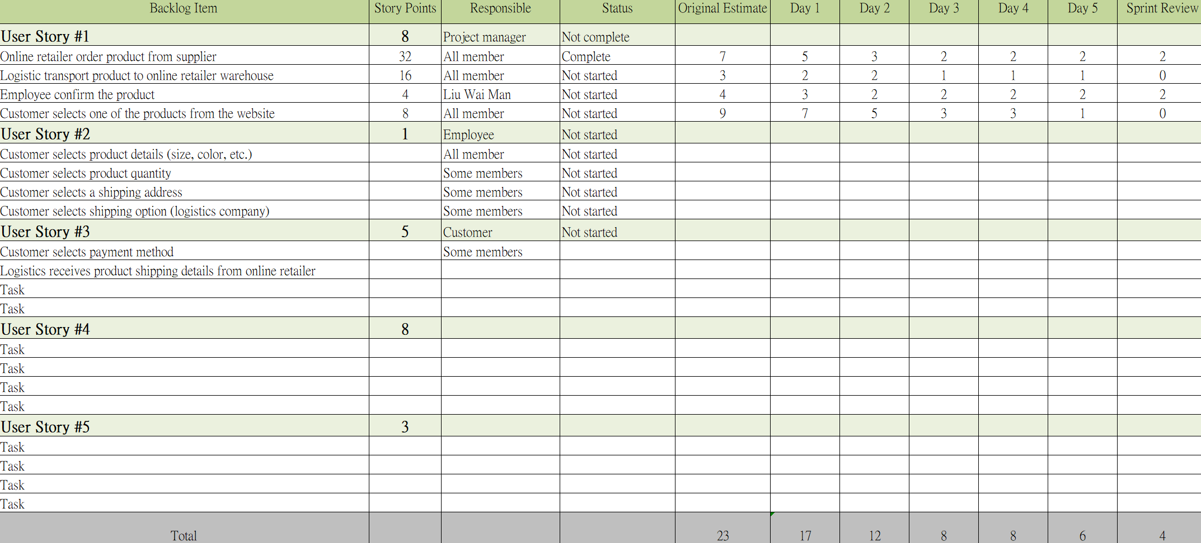
Sprint Backlog
Agile Methodology
Notes:
This is the sprint Backlog Shown in the above. This Sprint Backlog recorded the user story in five working day.
As we can see the working progress in this backlog, our staffs can Deeply and rightly understand our online retailer operation.

Slide 10
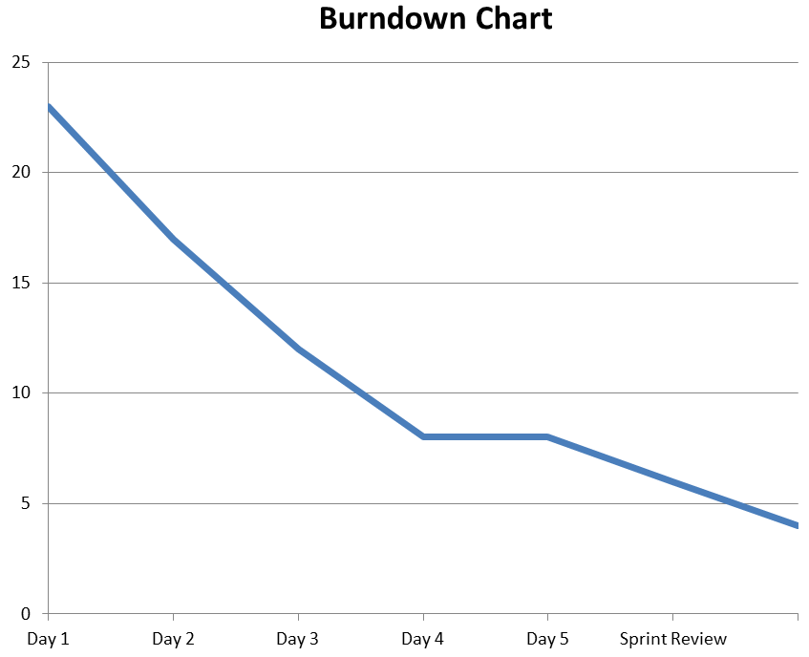
Burndown Chart
Agile Methodology
Notes:
The above Burndown Chart represent working progress and our team developments. in the diagram the Burndown chart is going down very smoothly, which means our online retailer project is doing well.

Slide 11
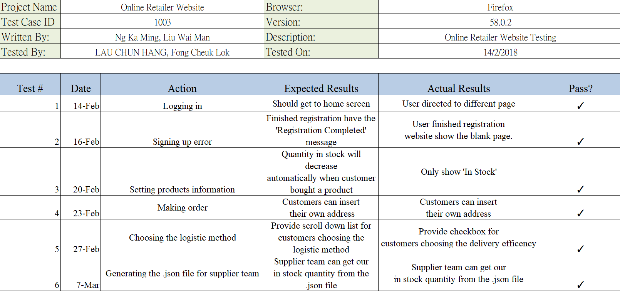
Test Plan
Notes:
Let’s move on Test Plan.
This Test Plan is tested by groupmate Victor and Andy. the report wrote by me Kami, Tommy and Raymond.
We point out some Actions for testing, also, we wrote about the Expected Results and the Actual Results.
We did 6 tests for the Test Plan.

Slide 12
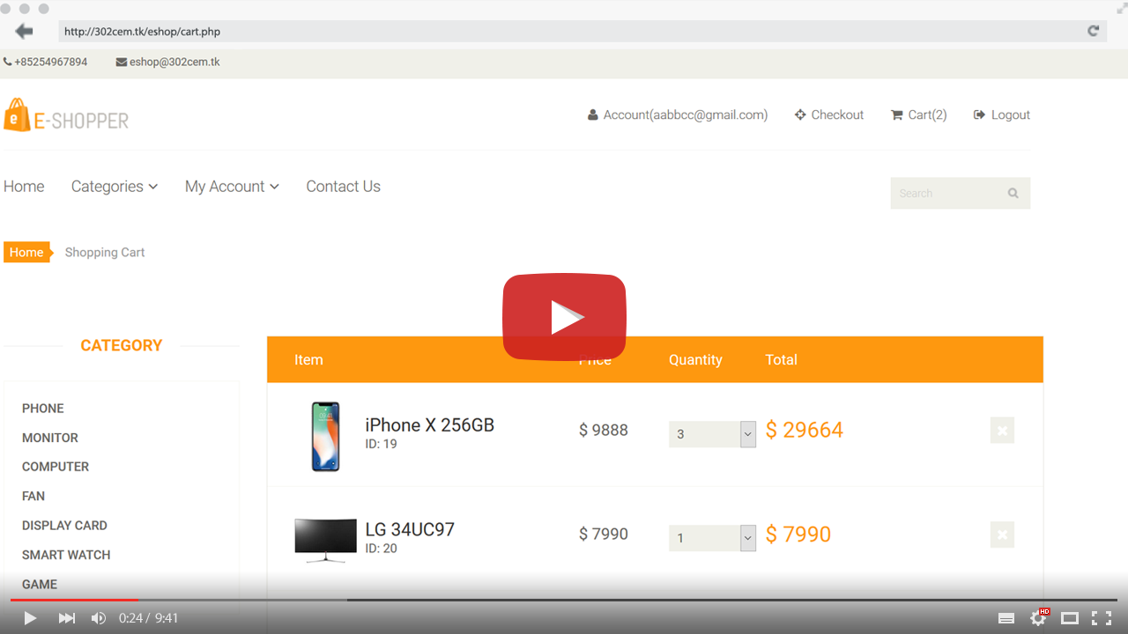
Link to your video cast
https://youtu.be/0j78XGtQxvw
https://github.com/victorlaulaulau/302cem_online_retailer_assessment

Slide 13


END
Notes:
Thank you for your attention. Now I am happy to answer any questions you might have.

